Slide 1
E-MEDICARE
PROJECT MEMBERS :-
A Madhuri Abhijit Shivaji Khude Abhishek Bhauso Dhavale Abhishek Vilas Deshmukh Aishwarya D G Akanksha Singh Akshay G N Ankita Debadarsani Das Ankush Babarao Kale Arjun V

Slide 2
ABSTRACT
The purpose of E-Medicare System is to automate the existing manual system by the help of computerized equipment's and full-fledged computer software, fulfilling their requirements, so that their valuable data can be stored for a longer period with easy accessing and manipulation of the same.
E-Medicare System, as described above, can lead to error free, secure, reliable and fast management system.
The aim is to replace the existing manual system by E-Medicare , By Eliminating the middle man thus leading to the Profit of the company.

Slide 3
INTRODUCTION
The “Online E-Medicare Store” has been developed to override the problems prevailing in the practicing manual system. This software is supposed to eliminate and reduce the hardships faced by the existing system. Online Medical Store can lead to error free, secure, reliable and fast management system.
"Online E-Medicare Store" - web application ,where users can register, login, purchase medicines e.g. Antibiotics, Antipyretics. and manage their orders in the system.

Slide 4
PROPOSED SYSTEM
The proposed Online E-Medicare store system will completely Revolutionize the industry.
Searching of medicine, order medicine, billing and medicine stock can be maintained by a single click.
The order placed can be easily tracked At any time.

Slide 5
TECHNOLOGY USED
HTML : Page layout has been designed in HTML
CSS : CSS has been used for all the designing part
JavaScript : All the validation task and animations has been developed by JavaScript
Java : All the business logic has been written in Java
MySQL : MySQL database has been used as database for the project
Angular CLI : Command-line interface tool that we use to initialize.

Slide 6
ENVIRONMENT
The system will be developed on any Windows OS machine using J2EE, Hibernate and Spring.
Server – Apache Tomcat 8
Database – My SQL
My SQL J Connector
Node Version 10
Angular CLI
JDK 1.8
Spring Tool Suite

Slide 7
SEQUENCE DIAGRAM
Customer
Application interface
Medicine
Order
medicine
Checkout
Browse & select medicine
Query medicine
Authorize
Purchase
Get selected medicine
Sends back
Contact
Display
Price info

Slide 8
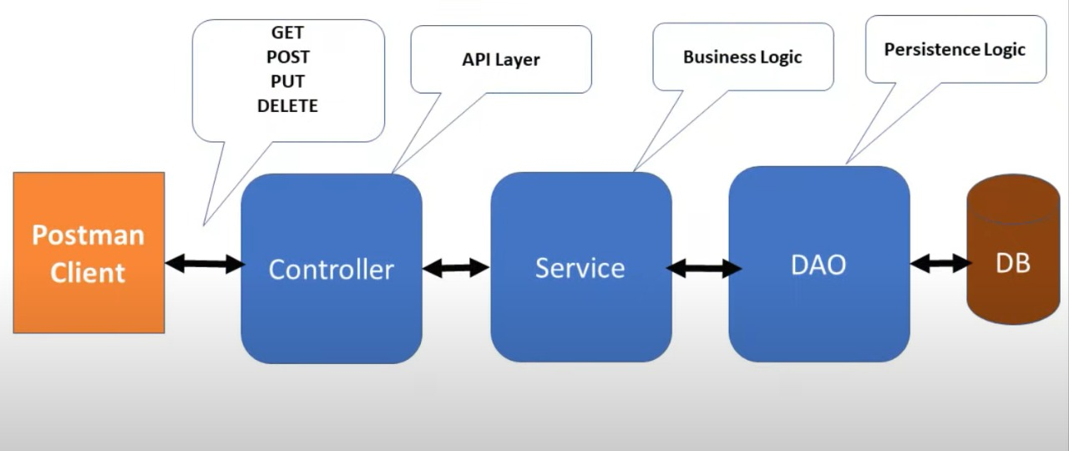
SPRING BOOT ARCHITECTURE

Slide 9
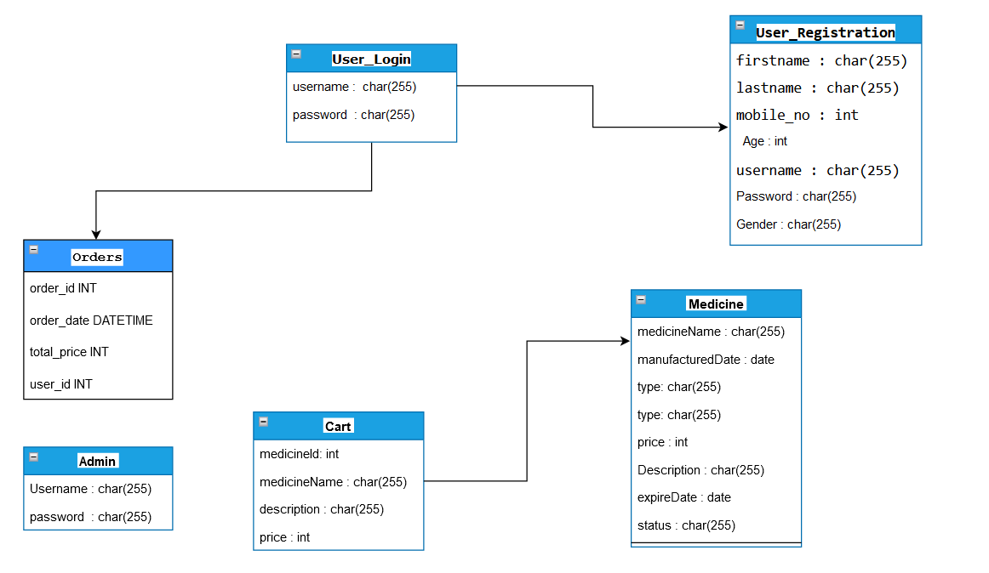
ER-DIAGRAM

Slide 10
MODULES OF E-MEDICARE SYSTEM
Admin Module
Users Module
Login Module
Order Module
Medicine Module
Cart Module

Slide 11
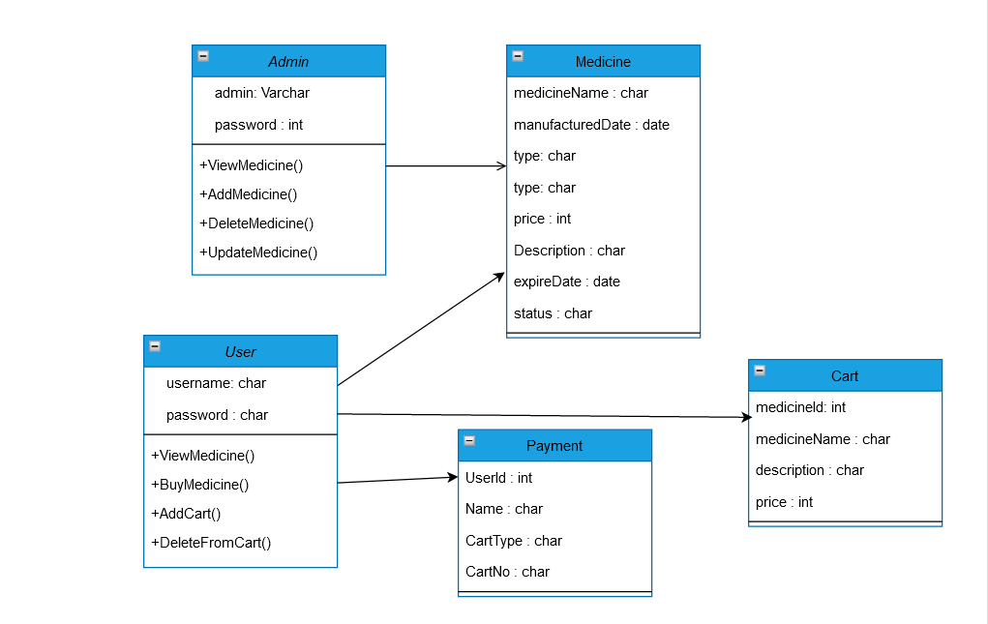
CLASS DIAGRAM

Slide 12
UNIT TESTING
JUnit is a unit testing framework for Java programming language. It plays a crucial role test-driven development, and is a family of unit testing frameworks collectively known as xUnit.
JUnit is an open source framework, which is used for writing and running tests.
Provides annotations to identify test methods.
Provides assertions for testing expected results.
Provides test runners for running tests.

Slide 13
FUNCTIONAL TESTING USING POSTMAN TOOL
Tests are automated by creating test suites that can run again and again.
Postman can be used to automate many types of tests including unit tests, functional tests, integration tests, end-to-end tests, regression tests, mock tests, etc. Automated testing prevents human error and streamlines testing.

Slide 14
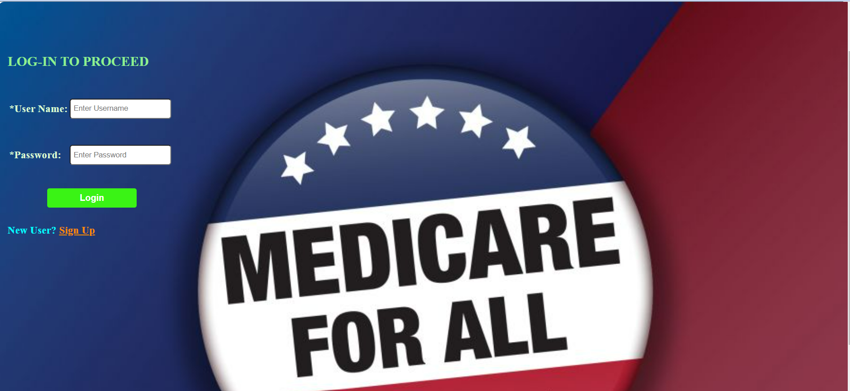
LOGIN PAGE

Slide 15
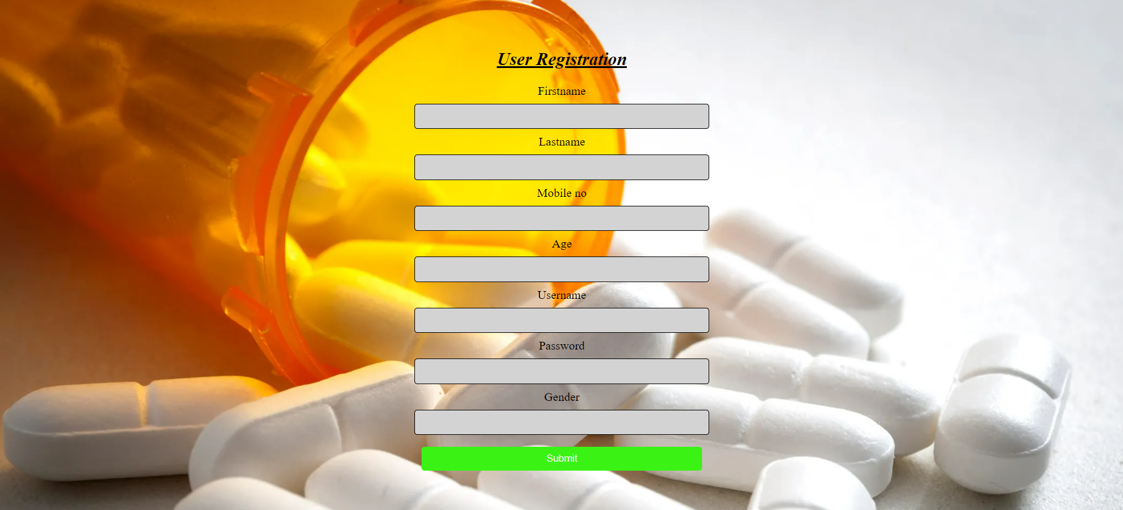
USER REGISTRATION PAGE

Slide 16
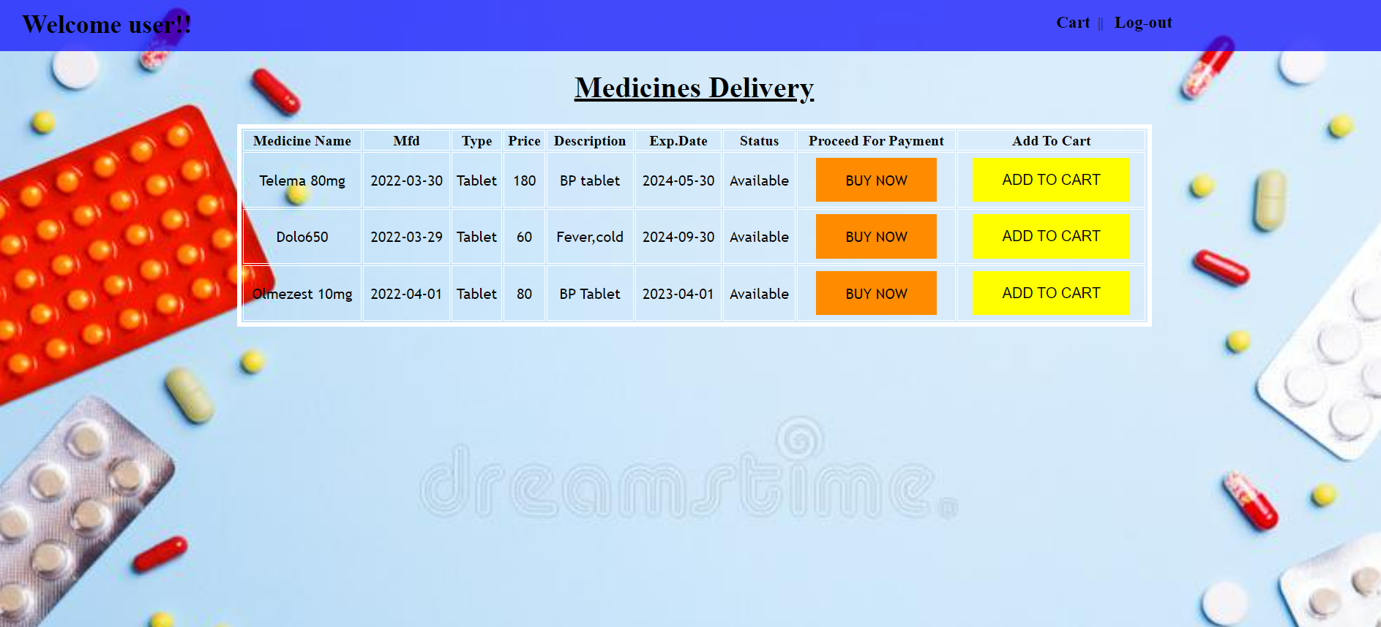
MEDICINES PAGE

Slide 17
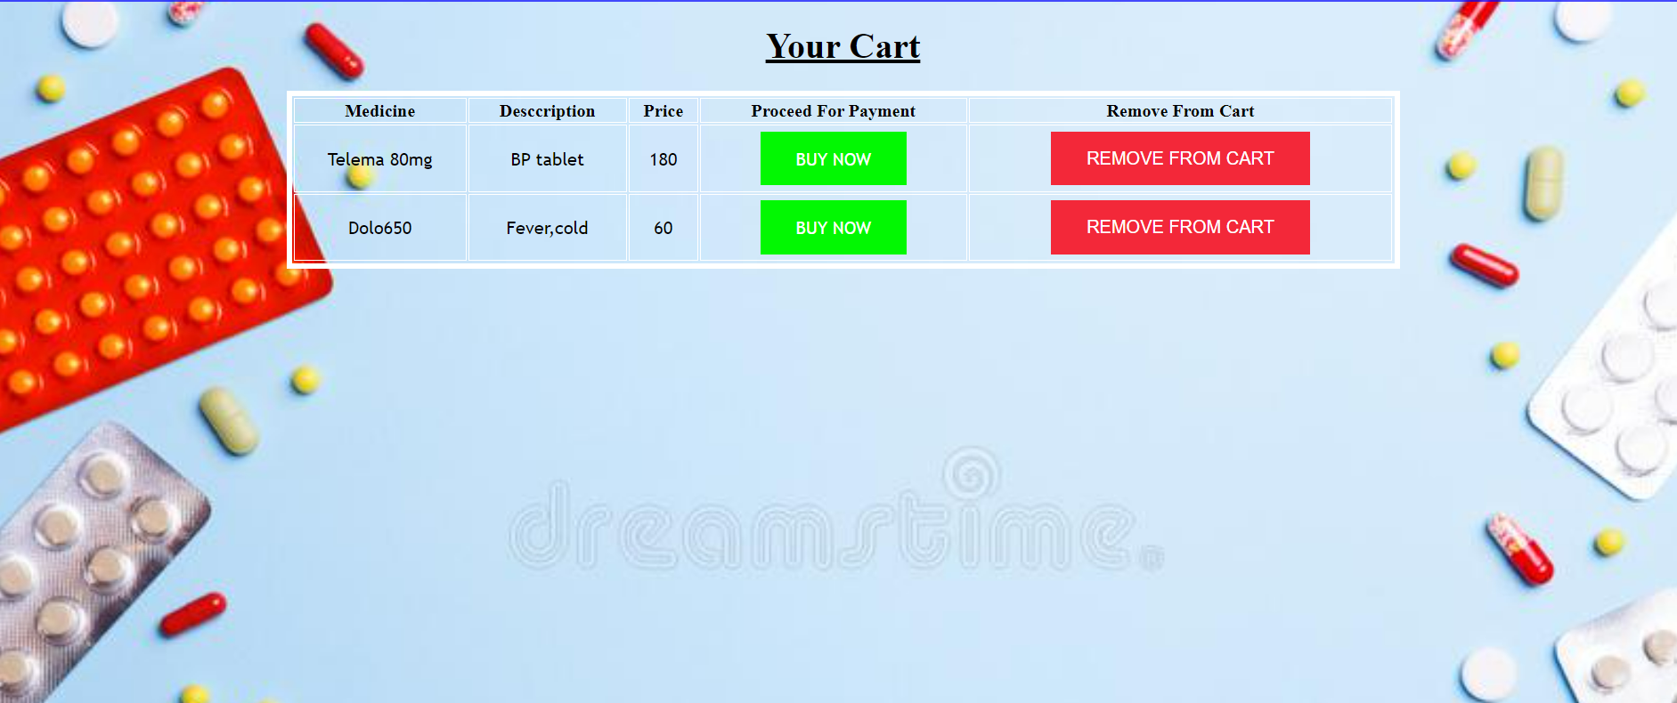
CART PAGE

Slide 18
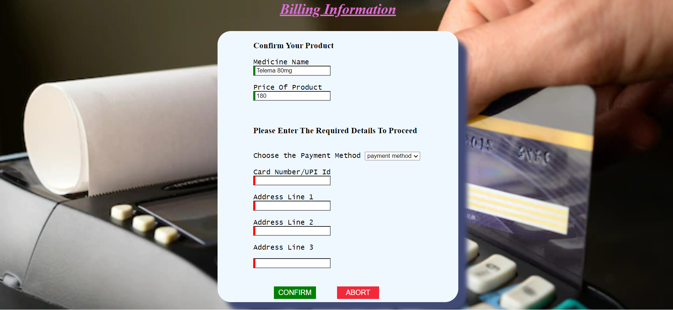
BILLING PAGE

Slide 19
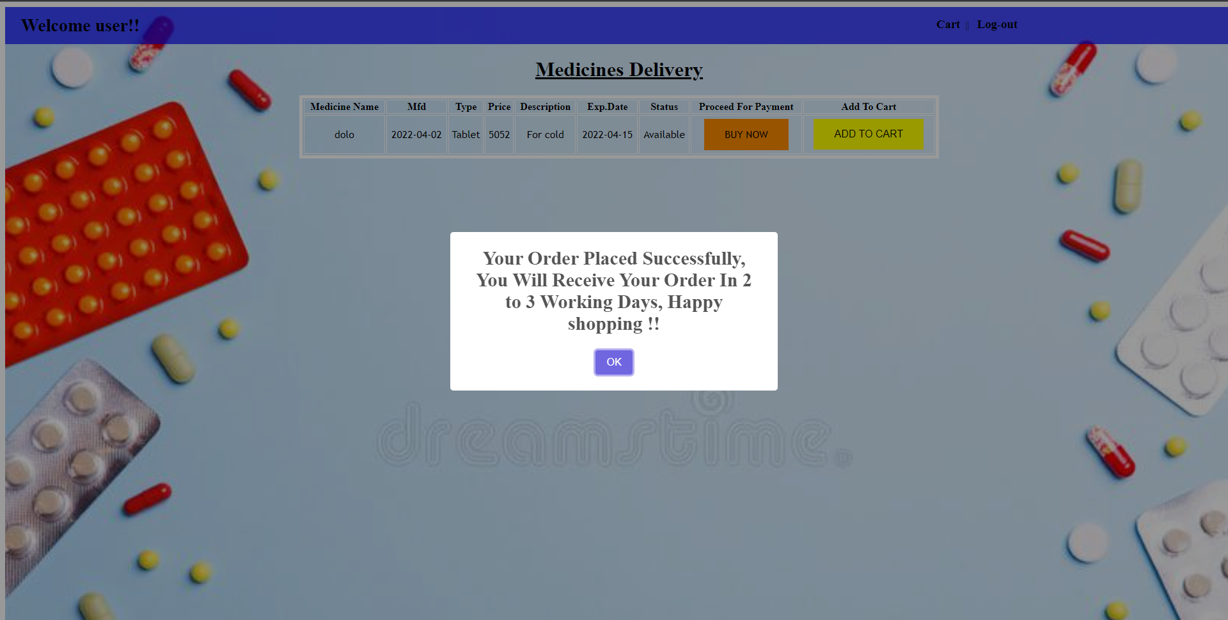
BILLING PAGE

Slide 20
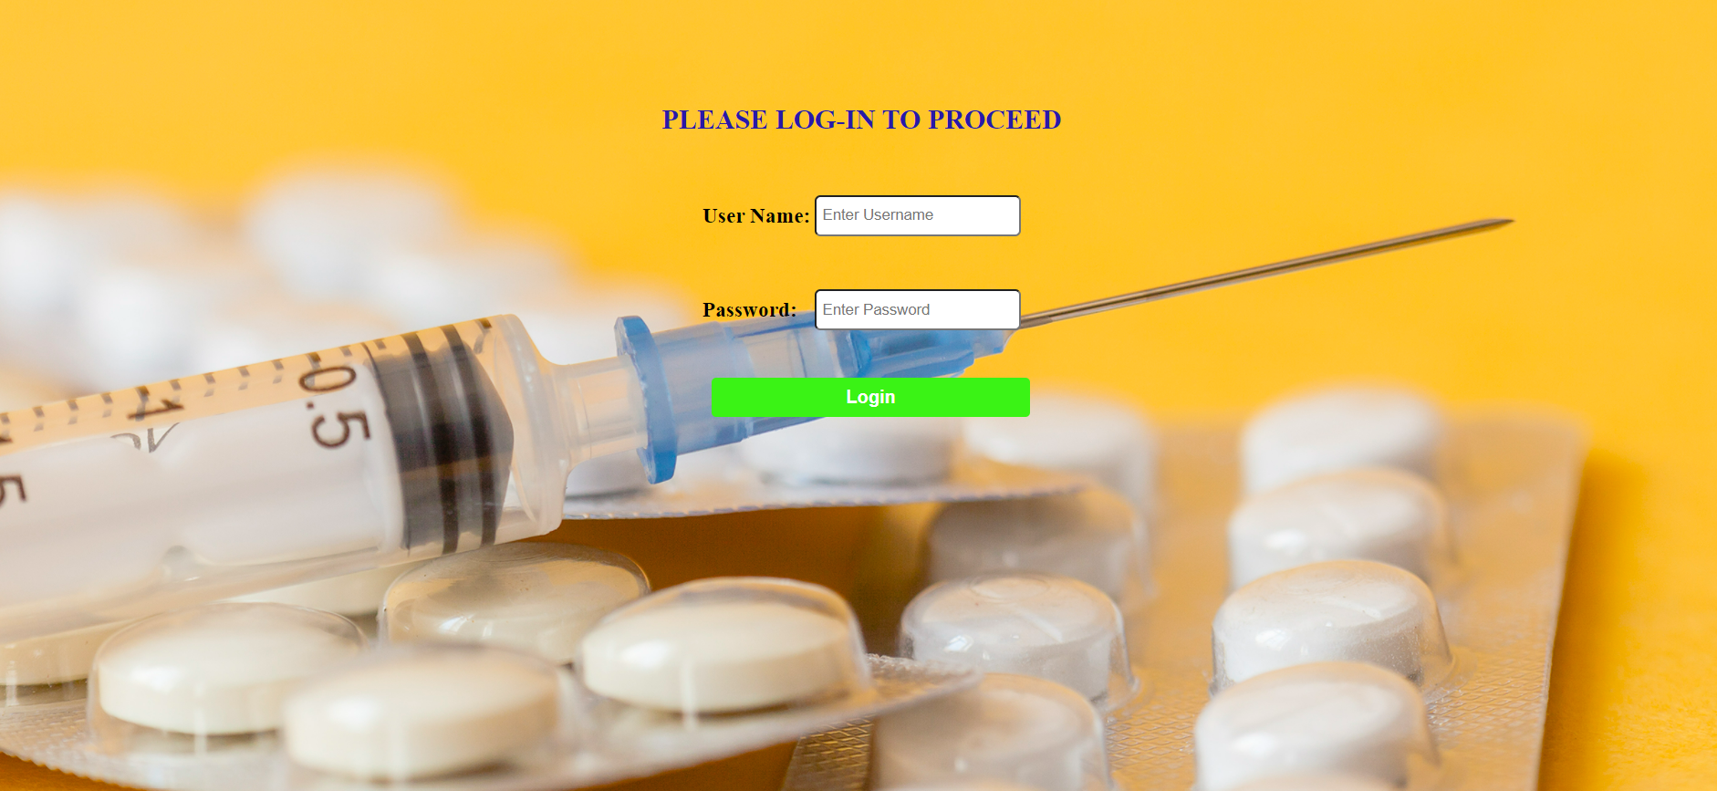
ADMIN PAGE

Slide 21
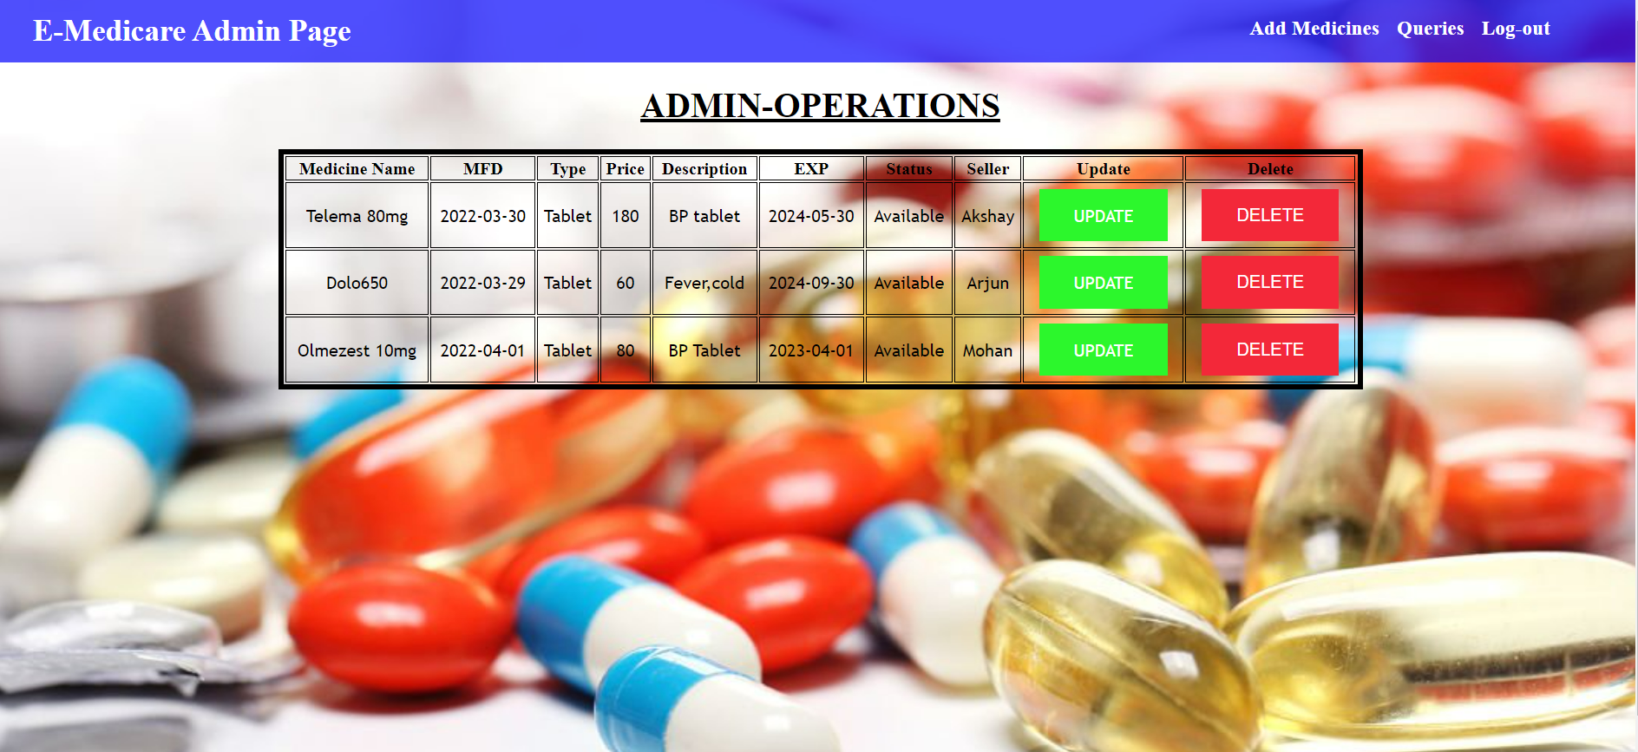
ADMIN OPERATIONS PAGE

Slide 22
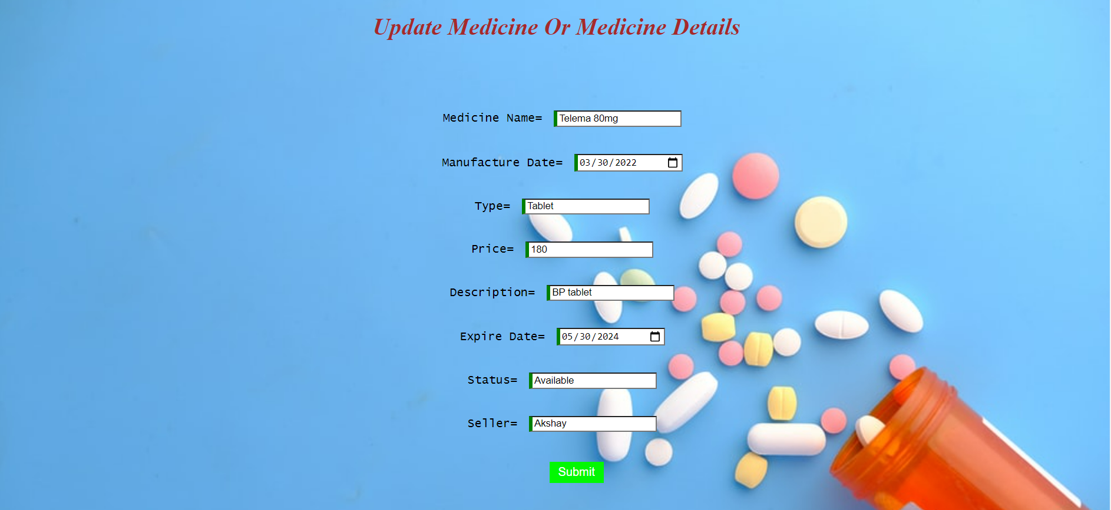
UPDATE MEDICINE PAGE

Slide 23
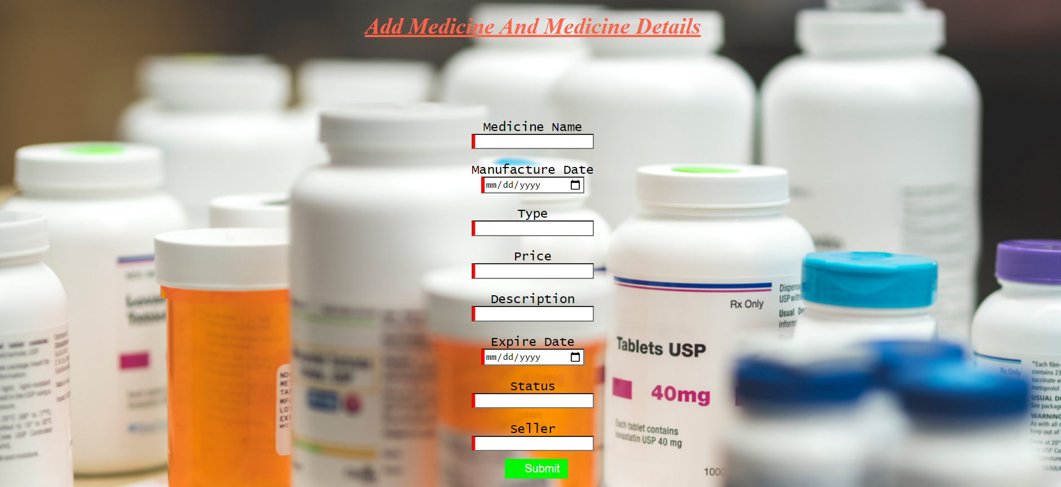
ADD MEDICINE PAGE

Slide 24
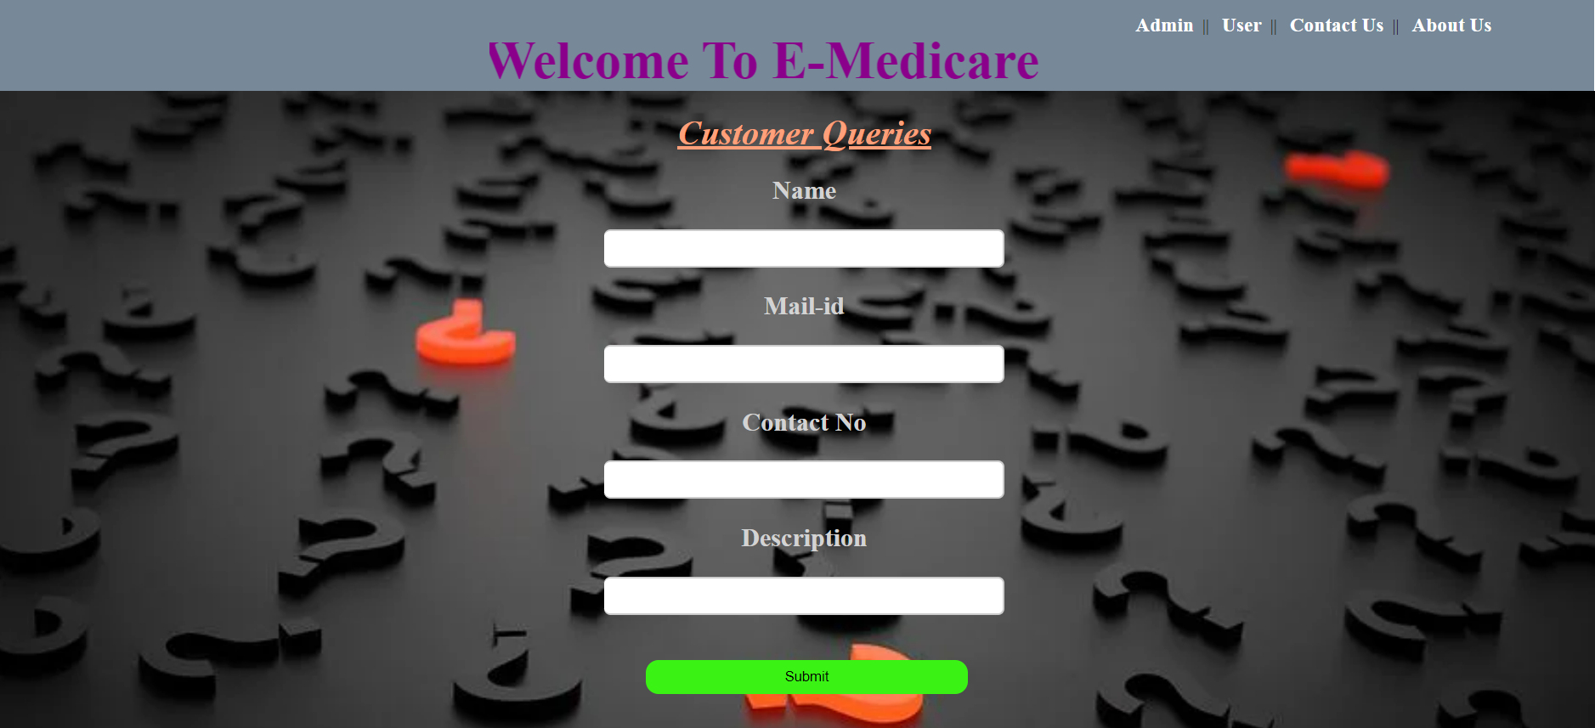
CONTACT US PAGE

Slide 25
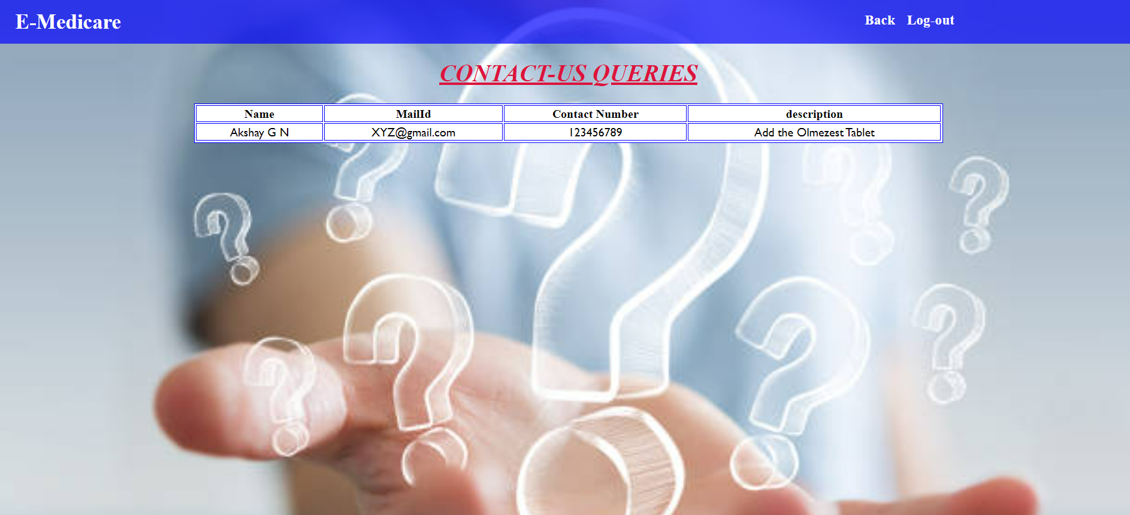
QUERIES PAGE

Slide 26
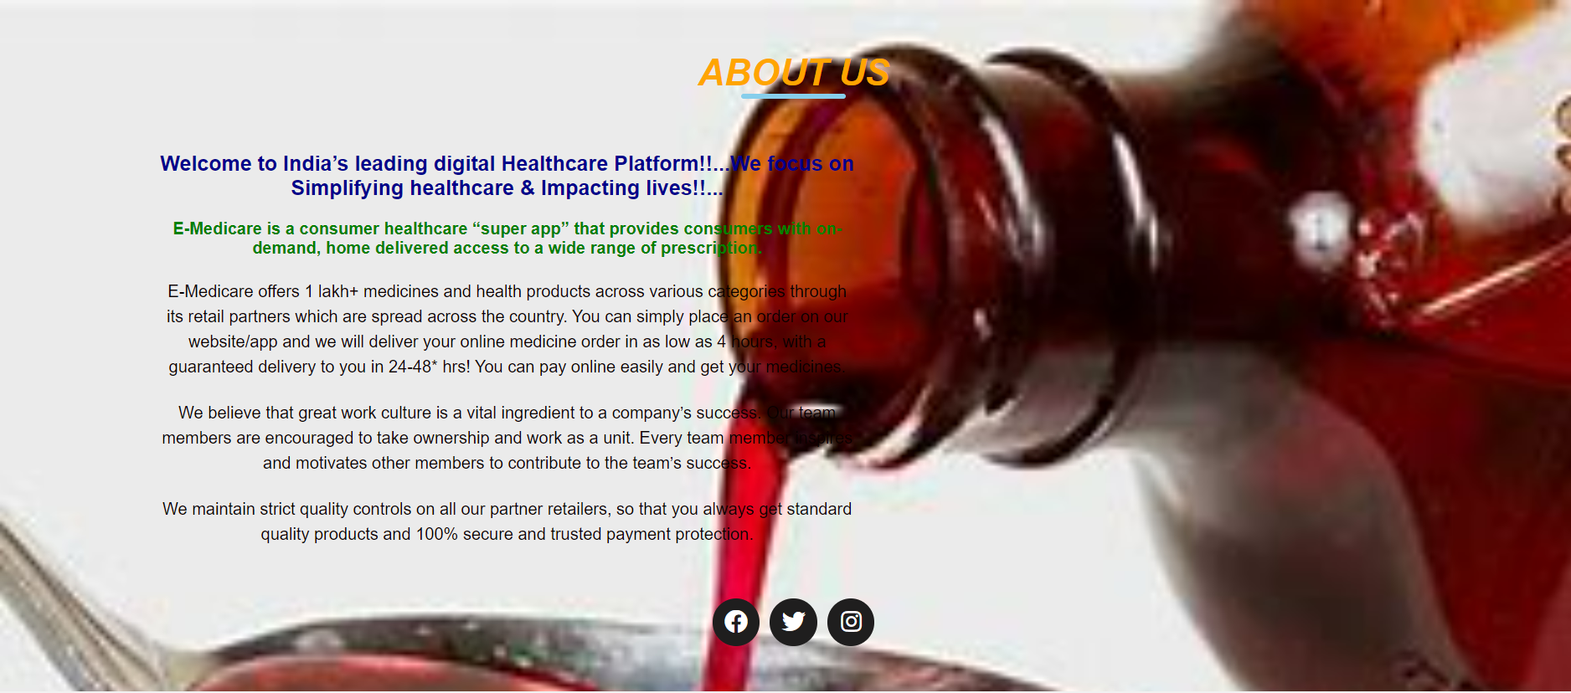
ABOUT US PAGE

Slide 27
ADVANTAGES
User can view details of the medicines Online.
It is convenient for users as this system provides accurate cost and description of the product.
The website is flexible to be used and for e-medicare.
User can view different categories of product of different pharma company at a single place.

Slide 28
CONCLUSION
This E Medicare system is a web-based application that assists in management of medicine in easy, comfortable and effective service.
The proposed application aims to create a friendly working environment for any Medicare centers and to overcome the drawbacks in existing system of Medicare management.
We understand the problem domain and produce a model of the system, which describes operations that can be performed on the system.
We included features and operations in detail, including screen layouts.
We designed user interface and security issues related to system.
Finally, the system is implemented and tested according to test cases.

Slide 29
THANK YOU

Slide 30
GO- TO DEMO

